Slide 1
Basic Math for Machine Learning

Slide 2
Key Topics
Statistics
Types of Data
Measuring Scales
Location & Shape of Data
Distribution of Data
Normal Distribution
Standard Normal Distribution
Properties of Normal Distribution
Hypothesis Testing
H0 & Ha hypothesis
P value
Type1 & Type2 Error
Pitfalls !!

Slide 3
Terminology Populations & Samples
Population: the complete set of individuals, objects or scores of interest.
Often too large to sample in its entirety
It may be real or hypothetical (e.g. the results from an experiment repeated ad infinitum)
Sample: A subset of the population.
A sample may be classified as random (each member has equal chance of being selected from a population) or convenience (what’s available).
Random selection attempts to ensure the sample is representative of the population.

Slide 4
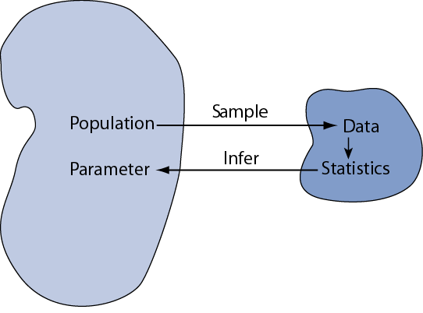

Slide 5
Variables
Variables are the quantities measured in a sample. They may be classified as:
Quantitative i.e. numerical
Continuous (e.g. pH of a sample, patient cholesterol levels)
Discrete (e.g. number of bacteria colonies in a culture)
Categorical
Nominal (e.g. gender, blood group)
Ordinal (ranked e.g. mild, moderate or severe illness). Often ordinal variables are re-coded to be quantitative.

Slide 6
Parameters & Statistics
Parameters: Quantities that describe a population characteristic. They are usually unknown and we wish to make statistical inferences about parameters. Different to perimeters.
Descriptive Statistics: Quantities and techniques used to describe a sample characteristic or illustrate the sample data e.g. mean, standard deviation, box-plot

Slide 7
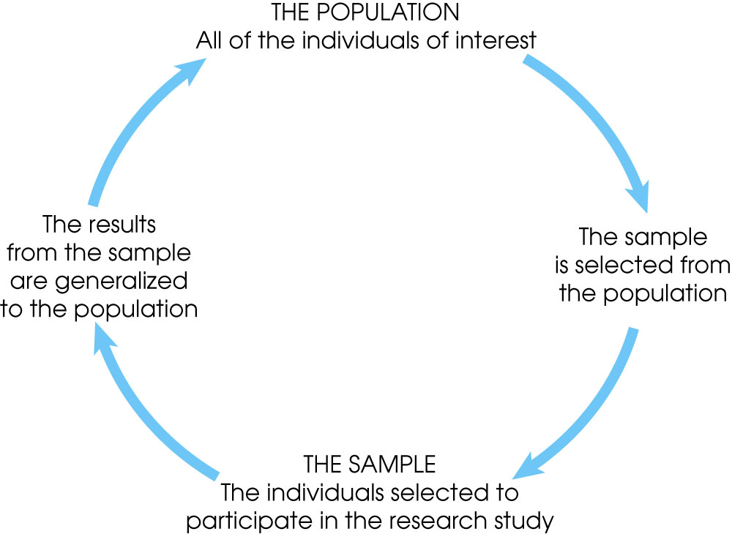

Slide 8
Measuring Scales – Quantitative Variable
An interval scale is an ordered series of equal-sized categories. Interval measurements identify the direction and magnitude of a difference. The zero point is located arbitrarily on an interval scale.
A ratio scale is an interval scale where a value of zero indicates none of the variable. Ratio measurements identify the direction and magnitude of differences and allow ratio comparisons of measurements.

Slide 9
Measuring Scales – Categorical Variable
A nominal scale is an unordered set of categories identified only by name. Nominal measurements only permit you to determine whether two individuals are the same or different.
An ordinal scale is an ordered set of categories. Ordinal measurements tell you the direction of difference between two individuals.

Slide 10
Types of Statistics
Descriptive statistics are methods for organizing and summarizing data.
For example, tables or graphs are used to organize data, and descriptive values such as the average score are used to summarize data.
Inferential statistics are methods for using sample data to make general conclusions (inferences) about populations.
Because a sample is typically only a part of the whole population, sample data provide only limited information about the population. As a result, sample statistics are generally imperfect representatives of the corresponding population parameters.

Slide 11
2. Frequency Distributions
An (Empirical) Frequency Distribution or Histogram for a continuous variable presents the counts of observations grouped within pre-specified classes or groups
A Relative Frequency Distribution presents the corresponding proportions of observations within the classes
A Barchart presents the frequencies for a categorical variable

Slide 12
Frequency Distributions - Example
Blood samples taken from 36 male volunteers as part of a medical examinations.
121 | 82 | 100 | 151 | 68 | 58
95 | 145 | 64 | 201 | 101 | 163
84 | 57 | 139 | 60 | 78 | 94
119 | 104 | 110 | 113 | 118 | 203
62 | 83 | 67 | 93 | 92 | 110
25 | 123 | 70 | 48 | 95 | 42

Slide 13
Relative Frequency Table
Serum CK (U/I) | Frequency | Relative Frequency | Cumulative Rel. Frequency
20-39 | 1 | 0.028 | 0.028
40-59 | 4 | 0.111 | 0.139
60-79 | 7 | 0.194 | 0.333
80-99 | 8 | 0.222 | 0.555
100-119 | 8 | 0.222 | 0.777
120-139 | 3 | 0.083 | 0.860
140-159 | 2 | 0.056 | 0.916
160-179 | 1 | 0.028 | 0.944
180-199 | 0 | 0.000 | 0.944
200-219 | 2 | 0.056 | 1.000
Total | 36 | 1.000

Slide 14
3. Measures of Central Tendency (Location)
Measures of location indicate where on the number line the data are to be found. Common measures of location are:
(i) the Arithmetic Mean,
(ii) the Median, and
(iii) the Mode

Slide 15
The Mean
Let x₁,x₂,x₃,…,x_{n} be the realised values of a random variable X, from a sample of size n. The sample arithmetic mean is defined as:

Slide 16
Example
Example 2: The systolic blood pressure of seven middle aged men were as follows:
151, 124, 132, 170, 146, 124 and 113.
The mean is
Notes:
The mean of the data in the sample of 36 CK measurements is given by

Slide 17
The Median and Mode
If the sample data are arranged in increasing order, the median is
the middle value if n is an odd number, or
midway between the two middle values if n is an even number
The mode is the most commonly occurring value.

Slide 18
Example 1 – n is odd
The reordered systolic blood pressure data seen earlier are:
113, 124, 124, 132, 146, 151, and 170.
The Median is the middle value of the ordered data, i.e. 132.
Two individuals have systolic blood pressure = 124 mm Hg, so the Mode is 124.

Slide 19
Example 2 – n is even
Six men with high cholesterol participated in a study to investigate the effects of diet on cholesterol level. At the beginning of the study, their cholesterol levels (mg/dL) were as follows:
366, 327, 274, 292, 274 and 230.
Rearrange the data in numerical order as follows:
230, 274, 274, 292, 327 and 366.
The Median is half way between the middle two readings, i.e. (274+292) ÷ 2 = 283.
Two men have the same cholesterol level- the Mode is 274.

Slide 20
Mean versus Median
Large sample values tend to inflate the mean. This will happen if the histogram of the data is right-skewed.
The median is not influenced by large sample values and is a better measure of centrality if the distribution is skewed.
Note if mean=median=mode then the data are said to be symmetrical
e.g. In the CK measurement study, the sample mean = 98.28. The median = 94.5, i.e. mean is larger than median indicating that mean is inflated by two large data values 201 and 203.

Slide 21
4. Measures of Dispersion
Measures of dispersion characterise how spread out the distribution is, i.e., how variable the data are.
Commonly used measures of dispersion include:
Range
Variance & Standard deviation
Coefficient of Variation (or relative standard deviation)
Inter-quartile range

Slide 22
Standard Deviation
The sample standard deviation, s, is the square-root of the variance
s has the advantage of being in the same units as the original variable x

Slide 23
Range
the sample Range is the difference between the largest and smallest observations in the sample
easy to calculate;
Blood pressure example: min=113 and max=170, so the range=57 mmHg
useful for “best” or “worst” case scenarios ☺
sensitive to extreme values ☹

Slide 24
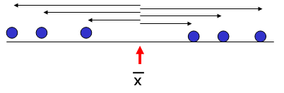
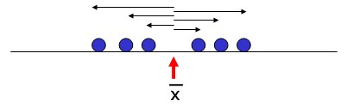
Sample Variance
The sample variance, s², is the arithmetic mean of the squared deviations from the sample mean:
>
Notes:
Why divide by n-1 in the formula for the sample standard deviation ?
The rationale for this arises from the fact that the sum of deviations sum to 0. Therefore, once the first n-1 deviations have been calculated, the last deviation is constrained, Therefore, in a sample of size n, there are only n-1 pieces of information concerning deviation from the average. The quantity n-1 is called the degrees of freedom of the sample standard deviation.
In practice, if n is large, regardless of whether one divides by n or n-1 doesn’t make much difference to the calculation of the sample standard deviation.

Slide 25
Example
Data | Deviation | Deviation²
151 | 13.86 | 192.02
124 | -13.14 | 172.73
132 | -5.14 | 26.45
170 | 32.86 | 1079.59
146 | 8.86 | 78.45
124 | -13.14 | 172.73
113 | -24.14 | 582.88
Sum = 960.0 | Sum = 0.00 | Sum = 2304.86

Slide 26
Example (contd.)
Therefore,

Slide 27
Coefficient of Variation
The coefficient of variation (CV) or relative standard deviation (RSD) is the sample standard deviation expressed as a percentage of the mean, i.e.
The CV is not affected by multiplicative changes in scale
Consequently, a useful way of comparing the dispersion of variables measured on different scales

Slide 28
Inter-quartile range
The Median divides a distribution into two halves.
The first and third quartiles (denoted Q₁ and Q₃) are defined as follows:
25% of the data lie below Q₁ (and 75% is above Q₁),
25% of the data lie above Q₃ (and 75% is below Q₃)
The inter-quartile range (IQR) is the difference between the first and third quartiles, i.e. IQR = Q₃- Q₁

Slide 29
Example
The ordered blood pressure data is:
113 124 124 132 146 151 170
Q₁ Q₃
Inter Quartile Range (IQR) is 151-124 = 27
Notes:
An alternative definition of Q₁ and Q₃ is based on Q₁ having a rank position = 0.25×(n+1) and Q₃ having rank position = 0.75×(n+1), where n is the sample size.
If n=10, then Q₁ would have rank position = 0.25×11=2.75 and Q₃ has rank position = 8.25 . Therefore Q₁ is found by interpolating between the second an third observations and Q₃ is found by interpolating between observations 8 and 9.
JMP software uses this definition of quartiles.

Slide 30
5. Box-plots
A box-plot is a visual description of the distribution based on
Minimum
Q1
Median
Q3
Maximum
Useful for comparing large sets of data

Slide 31
Example 1
The pulse rates of 12 individuals arranged in increasing order are:
62, 64, 68, 70, 70, 74, 74, 76, 76, 78, 78, 80
Q₁=(68+70)÷2 = 69, Q₃=(76+78)÷2 = 77
IQR = (77 – 69) = 8

Slide 32
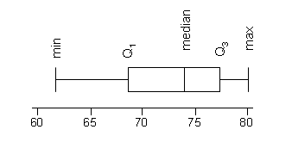
Example 1: Box-plot

Slide 33
Outliers
An outlier is an observation which does not appear to belong with the other data
Outliers can arise because of a measurement or recording error or because of equipment failure during an experiment, etc.
An outlier might be indicative of a sub-population, e.g. an abnormally low or high value in a medical test could indicate presence of an illness in the patient.

Slide 34
Outlier Boxplot
Re-define the upper and lower limits of the boxplots (the whisker lines) as:
Lower limit = Q₁-1.5×IQR, and
Upper limit = Q₃+1.5×IQR
Note that the lines may not go as far as these limits
If a data point is < lower limit or > upper limit, the data point is considered to be an outlier.

Slide 35
Theoretical Distributions & Hypothesis Testing

Slide 36
what is a distribution??
describes the ‘shape’ of a batch of numbers
the characteristics of a distribution can sometimes be defined using a small number of numeric descriptors called ‘parameters’

Slide 37
why??
can serve as a basis for standardized comparison of empirical distributions
can help us estimate confidence intervals for inferential statistics
form a basis for more advanced statistical methods
‘fit’ between observed distributions and certain theoretical distributions is an assumption of many statistical procedures

Slide 38
Normal (Gaussian) distribution
continuous distribution
tails stretch infinitely in both directions

Slide 39
μ
σ
σ
Properties of Normal Distribution
Symmetric, bell-shaped density function.
68% of area under the curve between μ ± σ.
95% of area under the curve between μ ± 2σ.
99.7% of area under the curve between μ ± 3σ.
symmetric around the mean (μ)
maximum height at μ
standard deviation (σ) is at the point of inflection

Slide 40
z-scores
standardizing values by re-expressing them in units of the standard deviation
measured away from the mean (where the mean is adjusted to equal 0)

Slide 41
Purpose of Standard Normal Distribution
z-scores = “standard normal deviates”
converting number sets from a normal distribution to z-scores:
presents data in a standard form that can be easily compared to other distributions
mean = 0
standard deviation = 1

Slide 42
z-scores often summarized in table form as a CDF (cumulative density function)
can use in various ways, including determining how different proportions of a batch are distributed “under the curve”

Slide 43
Neanderthal stature
population of Neanderthal skeletons
stature estimates appear to follow an approximately normal distribution…
mean = 163.7 cm
sd = 5.79 cm

Slide 44
Quest. 1: what proportion of the population is >165 cm?
z-score = ?
z-score = (165-163.7)/5.79 = .23 (+)
mean = 163.7 cm
sd = 5.79 cm

Slide 45
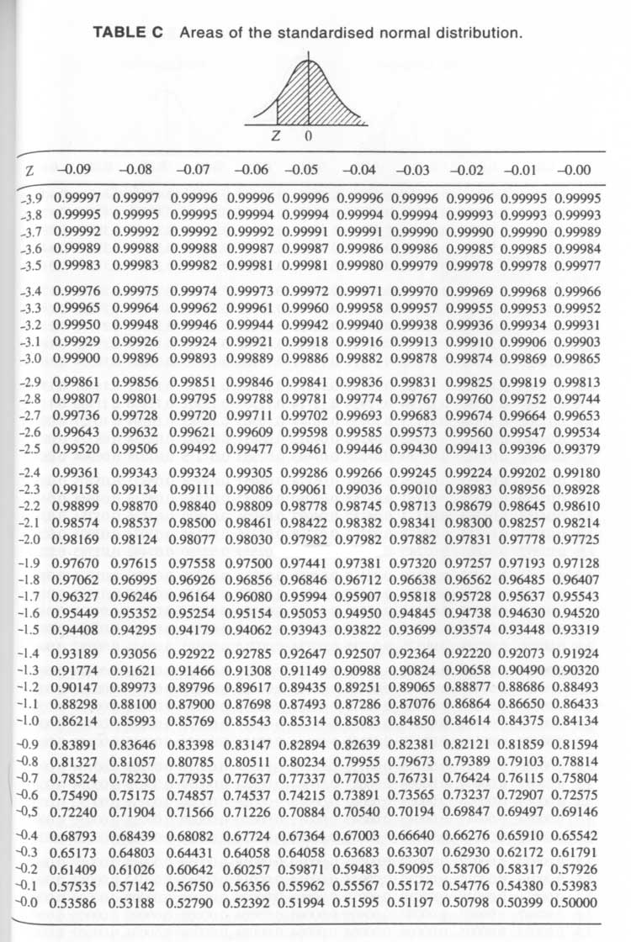
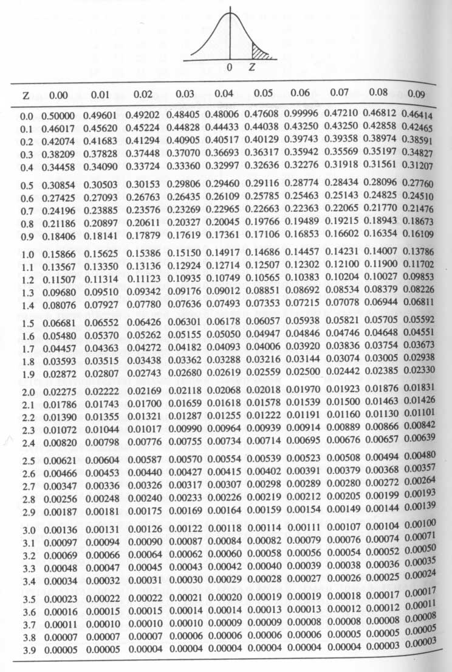
.48803
.48405
.48006
.47608

Slide 46
Quest. 1: what proportion of the population is >165 cm?
z-score = .23 (+)
using Table C-2
cdf(.23) = .40905
40.9%

Slide 47
Quest. 2: 98% of the population fall below what height?
Cdf(x)=.98
can use either table
Table C-1; look for .98
Table C-2; look for .02

Slide 48
.48803
.48405
.48006
.47608

Slide 49
Quest. 2: 98% of the population fall below what height?
Cdf(x)=.98
can use either table
Table C-1; look for .98
Table C-2; look for .02
both give you a value of 2.05 for z
solve z-score formula for x:
x = 2.05*5.79+163.7 = 175.6cm

Slide 50
hypothesis testing
originally used where decisions had to be made
now more widely used—even where evaluation of data would be more appropriate
involves testing the relative strength of null vs. alternative hypotheses

Slide 51
“null hypothesis”
H₀
usually highly specific and explicit
often a hypothesis that we suspect is wrong, and wish to disprove
e.g.:
the means of two populations are the same (H₀:μ₁=μ₂ )
two variables are independent
two distributions are the same

Slide 52
“alternative hypothesis”
H₁
what is logically implied when H₀ is false
often quite general or nebulous compared to H₀
the means of two populations are different: H₁:μ₁< >μ₂

Slide 53
what can go wrong???
since we can never know the true state of underlying population, we always run the risk of making the wrong decision…

Slide 54
Type 1 error
P(rejecting H₀|H₀ is true)
probability of rejecting a true null hypothesis
e.g.: deciding that two population means are different when they really are the same
P = significance level of the test = alpha (α)
in “classic” usage, set before the test

Slide 55
smaller alpha values are more conservative from the point of view of Type I errors
compare a alpha-level of .01 and .05:
we accept the null hypothesis unless the sample is so unusual that we would only expect to observe it 1 in 100 and 5 in 100 times (respectively) due to random chance
the larger value (.05) means we will accept less unusual sample data as evidence that H₀ is false
the probability of falsely rejecting it (i.e., a Type I error) is higher

Slide 56
the more conservative (smaller) alpha is set to, the greater the probability associated with another kind of error—Type II error

Slide 57
Type II error
P(accepting H₀|H₀ is false)
failing to reject the null hypothesis when it actually is false
the probability of a Type II error (β) is generally unknown

Slide 58
the relative costs of Type I vs. Type II errors vary according to context
in general, Type I errors are more of a problem
e.g., claiming a significant pattern where none exists
 | H₀ is correct | H₀ is incorrect
H₀ is accepted | correct decision | Type II error (β)
H₀ is rejected | Type I error (α) | correct decision

Slide 59
problems…
a) hypothesis testing often doesn’t answer very directly the questions we are interested in
we don’t usually have to make a decision in archaeology
we often want to evaluate the strength or weakness of some proposition or hypothesis

Slide 60
we would like to use sample data to tell us about populations of interest:
P(P|D)
but, hypothesis testing uses assumptions about populations to tell us about our sample data:
P(D|P) or P(D|H₀ is true)

Slide 61
b) classical hypothesis testing encourages uncritical adherence to traditional procedures
“fix the alpha level before the test, and never change it”
“use ‘standard’ alpha levels: .05, .01”
→ if you fail to reject the H₀, there seems to be nothing more to say about the matter…

Slide 62
better to report the actual alpha value associated with the statistic, rather than just whether or not the statistic falls into an arbitrarly defined critical region
most computer programs do return a specific alpha level
you may get a reported alpha of .000
not the same as “0”
means α < .0005 (←report it like this)

Slide 63
α
.05
χ²
accept H₀
reject H₀
critical: 3.84
observed: 4.84
α .016
χ² observed: 4.84

Slide 64
The whole approach may be logically flawed:
what if the tests lead you to reject H₀?
this implies that H₀ is false
but the probabilities that you used to reject it are based on the assumption that H₀ is true; if H₀ is false, these odds no longer apply
rejecting H₀ creates a catch-22; we accept the H₁, but now the probabilistic evidence for doing so is logically invalidated

Slide 65
That’s if for the Day !!!

